Slide 1
Treatments after precipitation
Peptization: a process by which a coagulated colloid returns to its dispersed state.
Digestion : following ppt, for a period of standing with heating the precipitate in contact with its mother liquor accelerate the ripening of crystalline particles.
Washing
Reprecipitation
Mother
liquor
ppt

Slide 2
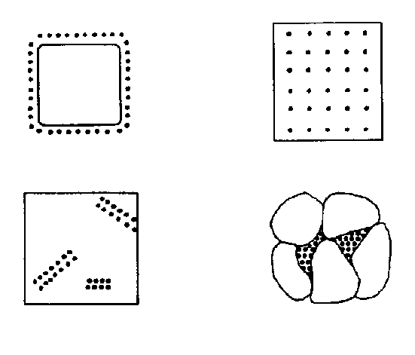
Impurities of ppt
co-precipitation
1) surface adsorption
2) mixed-crystal formation: inclusions:
impurity ions that
randomly occupy
crystal lattice
3) occlusions :
pockets of impurities that are literally trapped inside the growing crystal
4) mechanical entrapment
A
B
C
D

Slide 3
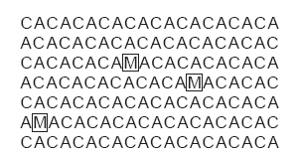
Inclusions
Potential interfering ions whose size and charge are similar to a lattice ion may substitute into the lattice structure
The interferent precipitates with the same crystal structure
The probability of forming an inclusion is greatest when the interfering ion is present at substantially higher concentrations than the dissolved lattice ion
The presence of an inclusion does not decrease the amount of analyte that precipitates
Thus, the precipitate’s mass is always larger than expected

Slide 4
Inclusions
Inclusions are difficult to remove since the included material is chemically part of the crystal lattice
The only way to remove included material is through re-precipitation
After isolating the precipitate from the supernatant solution, it is dissolved in a small portion of a suitable solvent at an elevated temperature.
The solution is then cooled to re-form the precipitate
Since the concentration ratio of interferent to analyte is lower in the new solution than in the original supernatant solution, the mass percent of included material in the precipitate decreases

Slide 5
Inclusions
This process of re-precipitation is repeated as needed to completely remove the inclusion
Potential solubility losses of the analyte, however, cannot be ignored
Thus, reprecipitation requires a precipitate of low solubility, and a solvent for which there is a significant difference in the precipitate’s solubility as a function of temperature

Slide 6
Occlusions
Occlusions occur when physically adsorbed interfering ions become trapped within the growing precipitate
The most common mechanism occurs when physically adsorbed ions are surrounded by additional precipitate before they can be desorbed or displaced
In this case the precipitate’s mass is always greater than expected
Occlusions also form when rapid precipitation traps a pocket of solution within the growing precipitate
Since the trapped solution contains dissolved solids, the precipitate’s mass normally increases.

Slide 7
Occlusions
The mass of the precipitate may be less than expected, however, if the occluded material consists primarily of the analyte in a lower-molecular-weight form from that of the precipitate
Occlusions are minimized by maintaining the precipitate in equilibrium with its supernatant solution for an extended time
This process is called digestion and may be carried out at room temperature or at an elevated temperature
During digestion, the dynamic nature of the solubility–precipitation equilibrium, in which the precipitate dissolves and re-forms, ensures that occluded material is eventually exposed to the supernatant solution
Since the rate of dissolution and reprecipitation are slow, the chance of forming new occlusions is minimal.

Slide 8
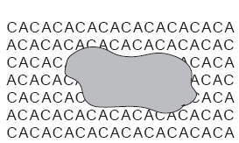
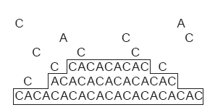

Slide 9
Other Impurities
Another source of impurities occurs when other species in solution precipitate under the conditions of the analysis.
Solution conditions necessary to minimize the solubility of a desired precipitate may lead to the formation of an additional precipitate that interferes in the analysis
For example, the precipitation of nickel dimethylgloxime requires a pH that is slightly basic. Under these conditions, however, any Fe³⁺ that might be present precipitates as Fe(OH)₃.

Slide 10
Finally, since most precipitants are not selective toward a single analyte, there is always a risk that the precipitant will react, sequentially, with more than one species
The formation of these additional precipitates can usually be minimized by carefully controlling solution conditions
Interferents forming precipitates that are less soluble than the analyte may be precipitated and removed by filtration, leaving the analyte behind in solution.

Slide 11
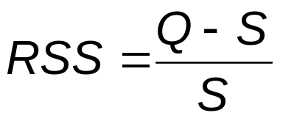
Homogeneous Precipitation
As the precipitate forms there is steady decrease in RSS
Precipitation time increases
One solution is to chemically generate the precipitant in solution as the product of a slow chemical reaction
This maintains the RSS at an effectively constant level.
The precipitate initially forms under conditions of low RSS, leading to the nucleation of a limited number of particles.
As additional precipitant is created, nucleation is eventually superseded by particle growth.
This process is called homogeneous precipitation

Slide 12

Homogeneous Precipitation
Two general methods are used for homogeneous precipitation:
If the precipitate’s solubility is pH-dependent, then the analyte and precipitant can be mixed under conditions in which precipitation does not occur. The pH is then raised or lowered as needed by chemically generating OH– or H₃O⁺. For example, the hydrolysis of urea can be used as a source of OH–.
CO(NH₂)₂(aq) + H₂O(l) CO₂(g) + 2NH₃(aq)
NH₃(aq) + H₂O(l) NH₄⁺(aq) + OH–(aq)
The hydrolysis of urea is strongly temperature-dependent, with the rate being negligible at room temperature.
The rate of hydrolysis, and thus the rate of precipitate formation, can be controlled by adjusting the solution’s temperature.

Slide 13
Homogeneous Precipitation
In the second method of homogeneous precipitation, the precipitant itself is generated by a chemical reaction. For example, Ba²⁺ can be homogeneously precipitated as BaSO₄ by hydrolyzing sulphamic acid to produce SO₄^{2–}.
NH₂SO₃H(aq) + 2H₂O(l) NH₄⁺(aq) + H₃O⁺(aq) + SO₄^{2–}(aq)

Slide 14
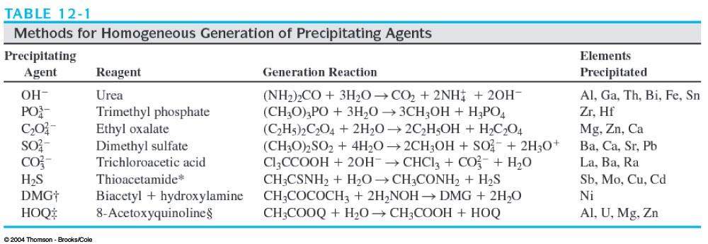

Slide 15
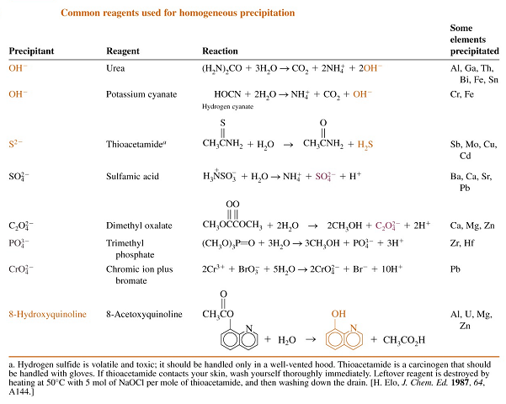

Slide 16
Example
Ex. Relating mass of product to mass of reactant
piperazine + 2 CH₃COOH → piperazine diacetate
FW 84.121 FW 60.053 FW 204.227 = 1 mol
x mol ppt 0.7121 g = x mol
y g
∴ x = 0.003487 mol y = 0.2933 g
Weight percent of piperazine in the commercial material (0.3126 g)
= (0.2933 / 0.3126)× 100 = 93.83 %

Slide 17
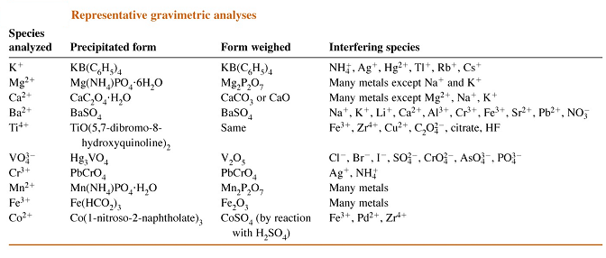

Slide 18
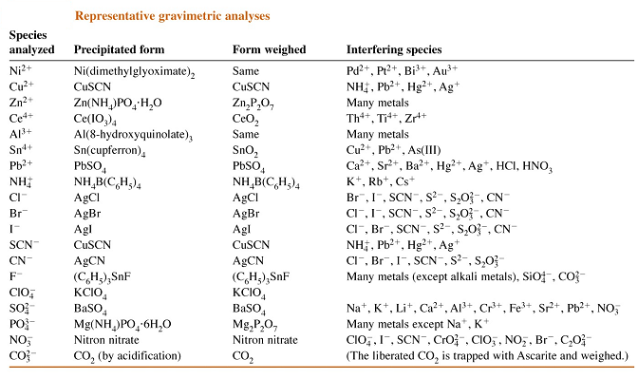

Slide 19
Combustion analysis
Combustion methods are useful for the analysis of carbon, hydrogen, nitrogen, sulfur, and halogen.
Catalyst
Pt gauze
CuO PbO₂ MnO₂
O₂
Sample in
Pt boat
Phosphorous pentoxide
NaOH
Absorb water
Absorb CO₂
Confirmation of a molecular formula is satisfactory when the
calculated and experimentally determined percentages agree within ±0.3%.

Slide 20
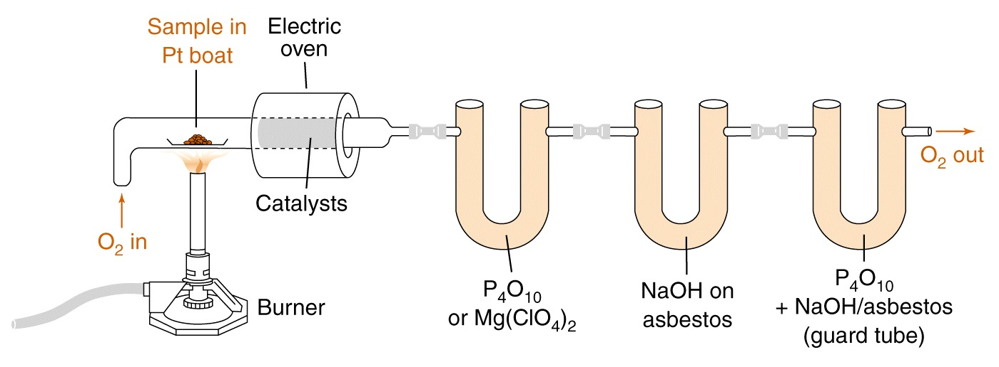
Gravimetric combustion analysis for carbon and hydrogen.

Slide 21
Example: Determination of masses of C, H by combustion analysis
Organic
compound
5.714mg
combust
CO₂ 14.414 mg
H₂O 2.529mg

